Slide 1


INVENTORY MANAGEMENT AND DEMAND FORECASTING OF THE BRIGHT BOX COMPANY, A MANUFACTURING FIRM, IN 2024
IITM Online BS Degree Program,
Indian Institute of Technology, Madras, Chennai
Tamil Nadu, India, 600036
The BDM Capstone Project, Presented By-
Aaliya Ansari
23ds3000181
Notes:
Good evening! I am Aaliya Ansari, here, to present my capstone project titled “Inventory management and demand forecasting of the BBC , a manufacturing firm, in 2024.

Slide 2
CONTENTS
THE ORGANIZATION
PROBLEM STATEMENTS
DATA COLLECTION
ANALYSIS
KEY FINDINGS
RECOMMENDATIONS
Notes:
In this presentation, we will be discussing about the background of the organization, the problems the organization is facing and the framed problem statements, then we will gr through the data collection process, the analysis performed on the data followed by the discussion on the key findings of the project and recommendations provided to the organization.

Slide 3
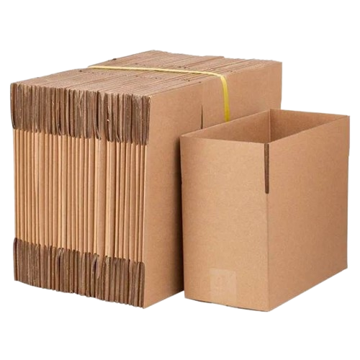

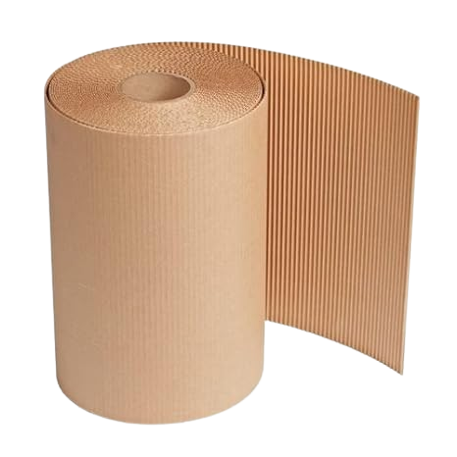
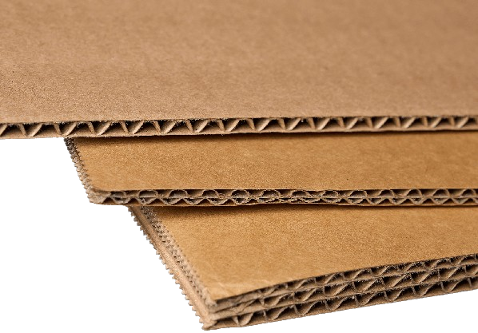
ORGANIZATION: THE BRIGHT BOX COMPANY
Owner- Mr. Humayun Anwar
Year of Establishment- 1993
Business Type- B2B
Product Line- Cartons, Corrugated Boxes & Sheets
Notes:
The project focuses on the bright box company which is a manufacturing firm located in Moradabad city of Uttarpradesh. The company was established in 1993 by Mr Humayun Anwar. This is a B2B oriented firm and deals in the manufacturing of corrugated boxes and cartons of various sizes and quality. Here you can see this is a corrugated box and this is a roll of corrugated sheet and these are some sheets. The main customers of the company are the exporters in the local market. Due to the global economic downturn, the business is currently facing low sales period. This is also due to the ongoing war, the inactive routes and inflation. it has hampered the inventory management, man power management and other fixed expenses management.

Slide 4
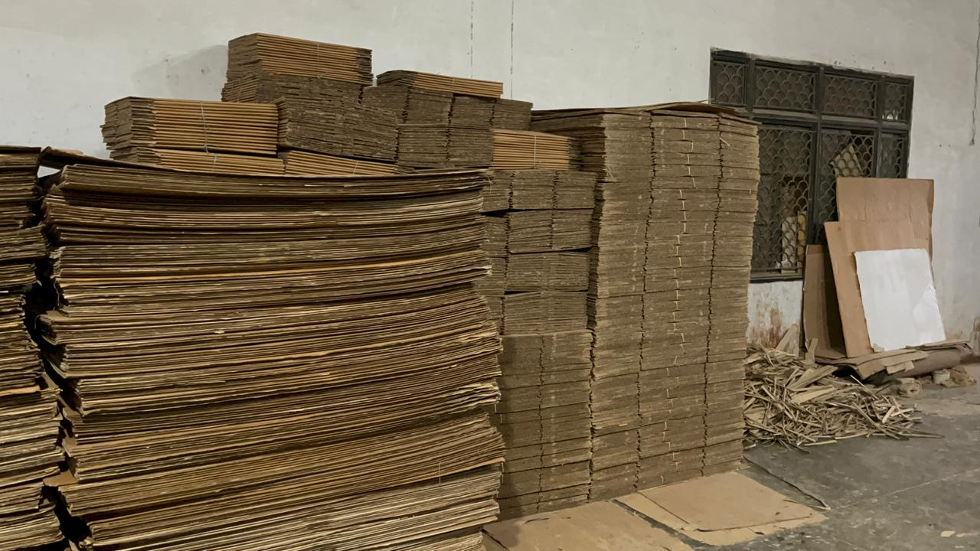
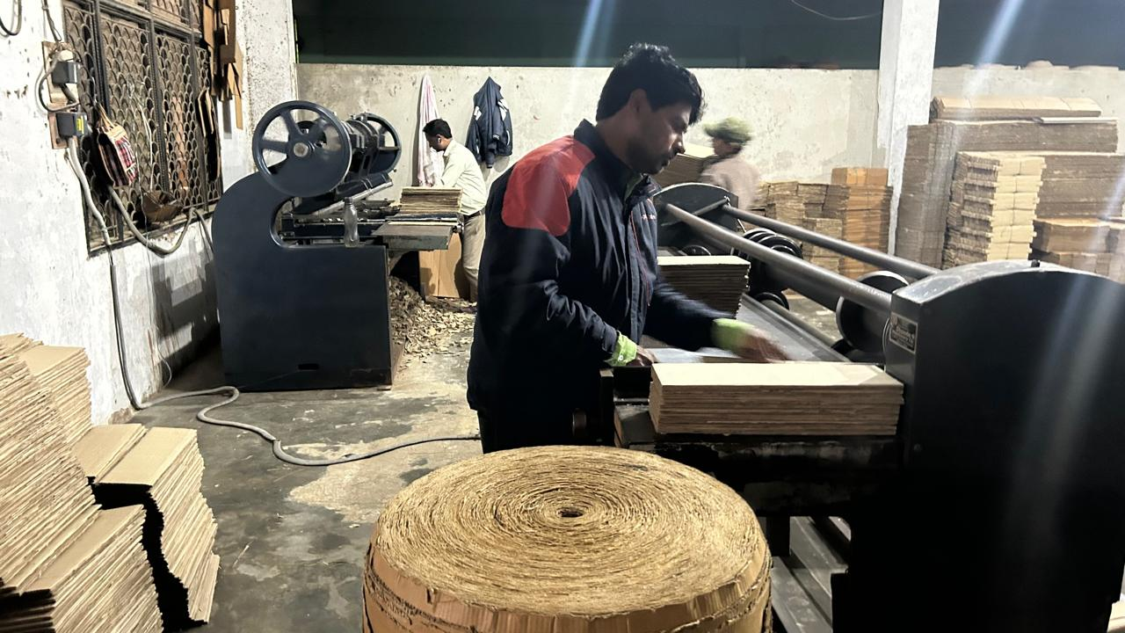
PROBLEM STATEMENTs
Management of Inventory during low demand in Industrial market, in Moradabad, Uttar Pradesh.
Identification of future scope and demand in the market for corrugated box manufacturing industry.
Management of working capital & manpower with low sales.
Notes:
After the discussion with the owner and the employees, the problem statements that I framed considering the situation of the organization are :

Slide 5
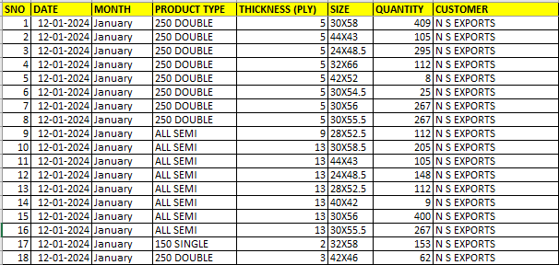
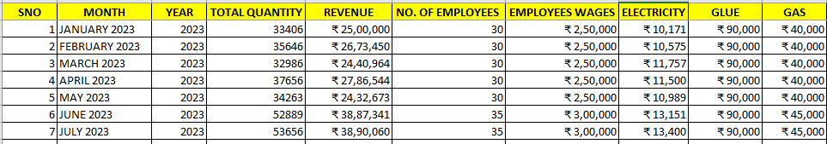
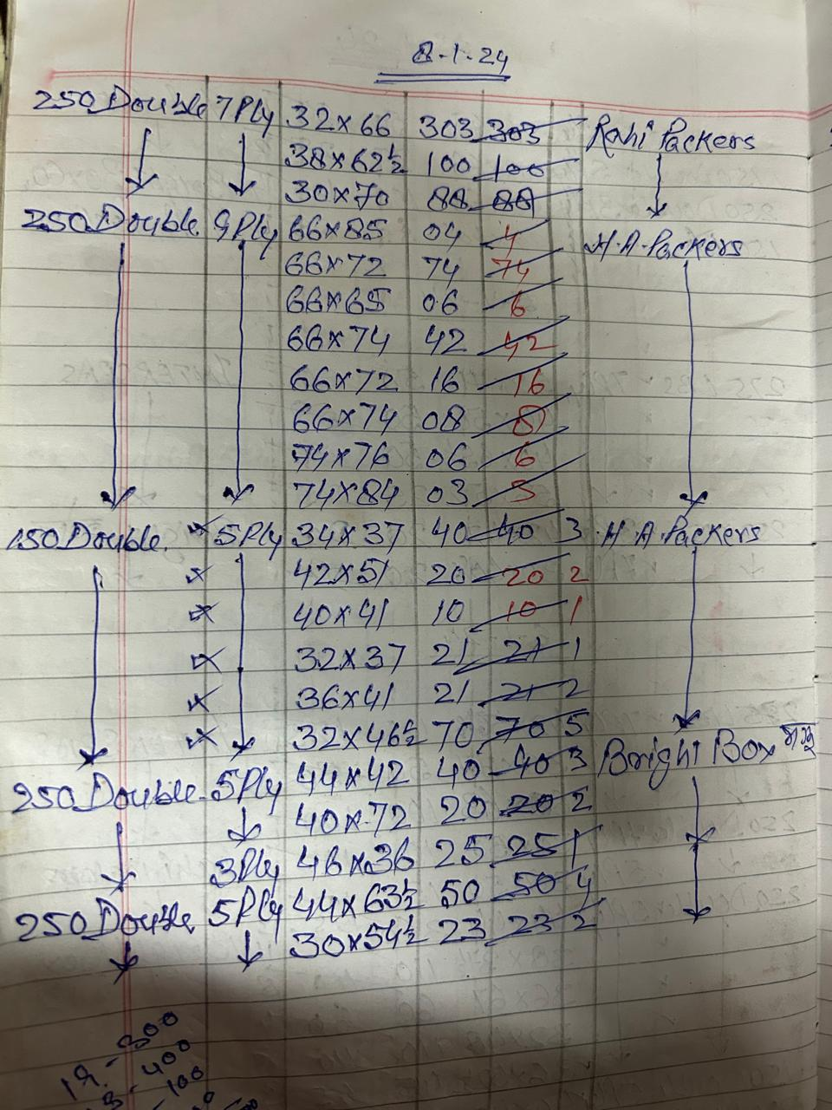
DATA COLLECTION
Type of data collection- Primary
Daily sales data
Monthly Revenue & Expenditure data
SLIDE | 5
Notes:
To address the problems, two types of data sets were collected : Daily sales data of 3 months duration i.e. from Novemebr 2023 to January 2024 (explanation)And a data set containing the monthly record of the revenue generated by the company, no of employees , fixed expenses etc (explanation)

Slide 6
Analysis
Data Cleaning & Pre-processing
Product Category Analysis
Customer Analysis
Revenue Analysis
Monthly Expenditure Analysis
Profitability Analysis
Fixed Cost Expenses Analysis
Forecasting
SLIDE | 6
Notes:
The procedure for analysis began with data cleaning and preprocessing. The data collected was in the form of rough notes and bills provided by the company which was then tabulated in excel and cleaned . It had outliers, some mis-spelled words, other terms which I wasnt aware of. These problems were resolved by having a conversation with the managerial team of the company. After the data cleaning, the analysis began. Several analysis were performed such as ------ MOVING ON TO OUR NEXT SLIDE

Slide 7
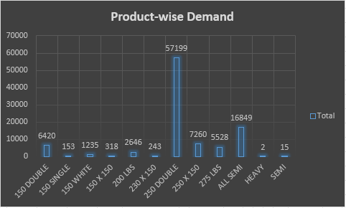
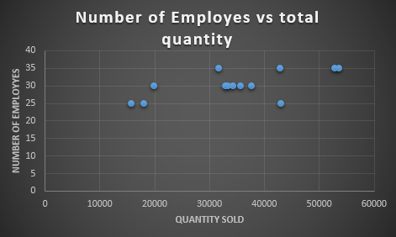
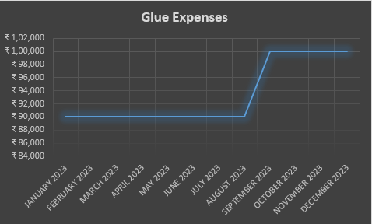
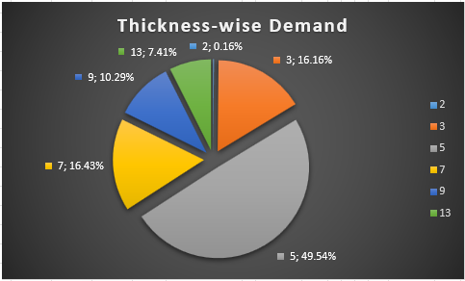
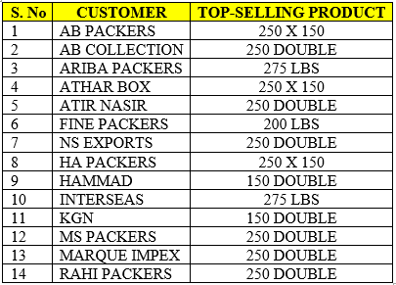
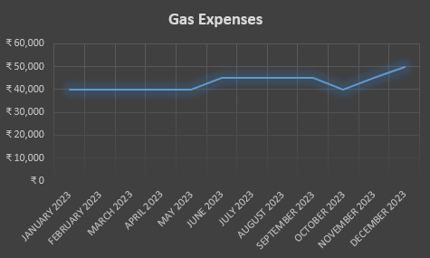
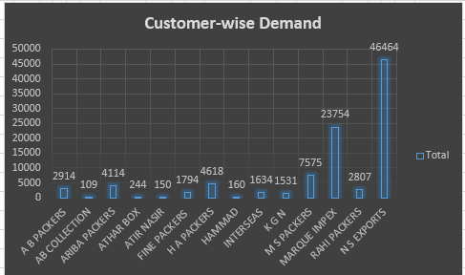
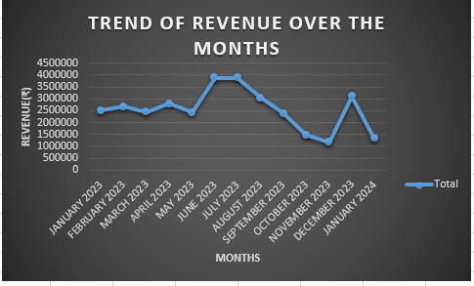
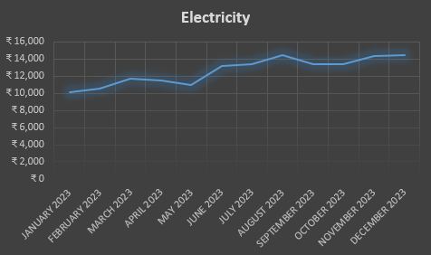
Analysis
Notes:
Before proceeding with the analysis let me just give you a brief outline of the products of the companyThe thickness of the paper is measured in GSM that is grams per square meter and thickness of the sheet is measured in ply. Sheets are crafted by layering various papers as per requirement. For instance, 230 *150 of 3 ply implies that the sheet contain three layers of paper the outer layers will be of 230 gSm and 150 gsm and the middle layer will be of 100 gsm paper.
PRODUCT WISE-DEMAND GRAPH shows that the top selling product is 250-double (which is a sheet made up of layers of 250 gsm paper) followed by ALL SEMI.
NEXT THE graph shows that 5 ply is the most in demand thickness category.
Customer wise demand shows that NS EXPORTS & MARQUE IMPEX ARE the KEY CUSTOMERS which contributes to about 72% of the total sales of the company.
Table
Revenue trend

Slide 8
Key findings
Star Performers-
Top Customers- Marque Impex & NS Exports
Top product- 250 double
Contributing 72% orders overall & 83% orders in 250 double category.
Products with constant demand- “250 X 150”, 150 Double, 275 LBS & 200 LBS.
There is a 54% hike in sales for the month of June-July 2024
Sales v/s employees Ratio-
Sale of 20,000 units consume 25 employees
The sale of 30,000-40,000 units consume 30 employees
The sales of 50,000-60,000 units consume 35 employees
Notes:
So, the key findings of the project are that the KEY CUSTOMERS ARE MARQUE IMPEX AND NS EXPORTS AND the star product is 250-double. MI AND NS contributes to about 72% of the total orders out of which 83% orders are of 250-double category.
The quantity sold in MAY and the quantity sold in June were take and the percentage increase in sales was calculated which revealed that there was a 54% increase in sales in the month of june-july so the company should be prepared for projected 54% hike in sales.

Slide 9


recommendations
To avoid Inventory issues- Company may focus on their Key customers and their Star product only. Utilizing the additional manpower in enquiry generation, customer relations and market research.
The sales are lowest in November, hence during that time the extra manpower can be utilized for Market Research & Sales Enquiries.
Providing required training in October.
Raw Material for 250 Double & 5 ply must be kept adequately in stock as they are the most in demand. Specially during the Sales peak period of June & July.
Products other than the TSP should ONLY be manufactured as Made-To-Order, during the period of July to November.
Based on past years data the Company should stock enough gas and glue before the months of June & October, and September respectively as there is an evident spike in prices.
Notes:
MARQUE IMPEX AND NS CONTRIBUTES TO ABOUT 72% OF THE TOTAL SALE QUANTITY OUT OF WHICH 83% INCLUDES THE 250-DOUBLE . Therefore, to avoid inventory issues the company should focus on its key customers and their requirement. The company could utilize its additional manpower in enquiry generation, customer relations and market research especially in the month of Novemeber when the sales are low. Any trainings that need to be provided should be provided in the month of October.
AS 250 double with 5 ply is the most in demand product stock of the same should be kept adequately in high sales period.
In conclusion , analysing the company’s sales data provided valuable information to make decisions. This includes improving how to manage inventory, predicting how much spike in the sales cpuld be observed , managing the staff when the sales are low. By following the suggestions, the company can steer the business thru tough times and make the most of opportunites in the corrugated box manufacturing industry.

Slide 10
THANK YOU!

